Slide 1

EMBEDDED SYSTEM CHANGES OUR LIFE
AFIQ AIMAN BIN AHMAD FAIRUZ RIZAL 1716851
MCTE 4342, Section 1
https://github.com/afiqaimanafr

Slide 2

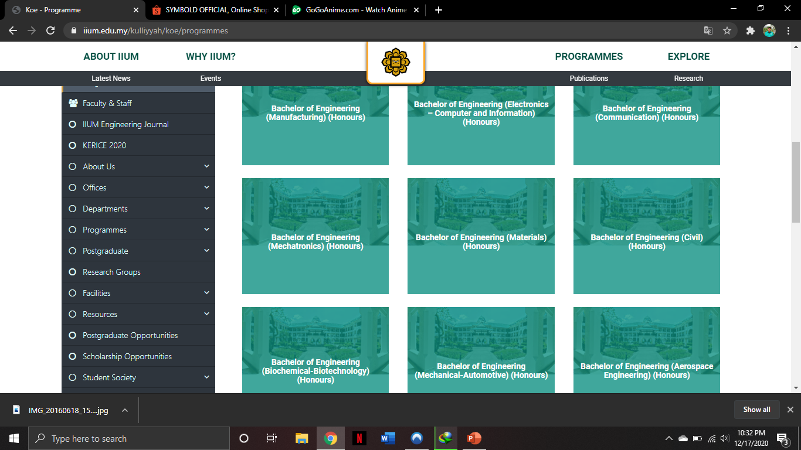
Kuliyyah of engineering

Slide 3
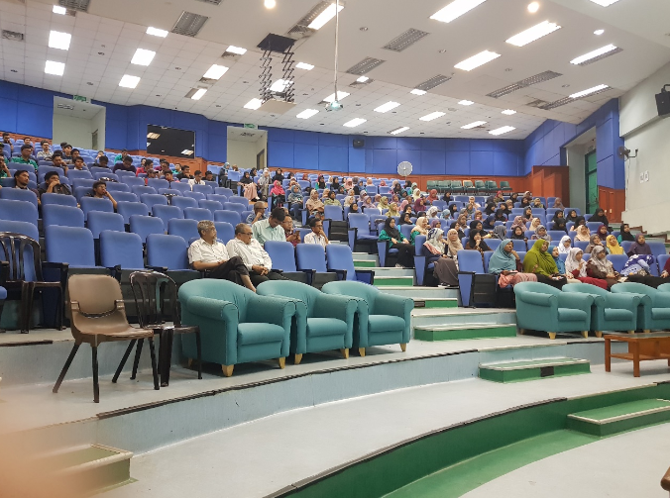


Slide 4
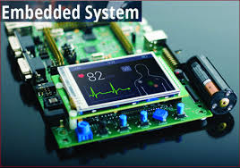
What is embedded system?
An embedded system is a microprocessor-based computer hardware system with software that is designed to perform a dedicated function, either as an independent system or as a part of a large system.

Slide 5
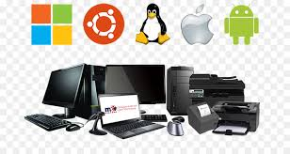
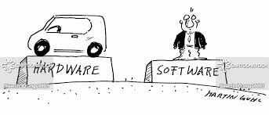
An embedded system is a special-purpose computer system designed to perform certain dedicated functions. It is usually embedded as part of a complete device including hardware and mechanical parts.
A combination of computer hardware and software

Slide 6
Basic structure
Sensor
A-D Converter
D-A Converter
Actuator

Slide 7
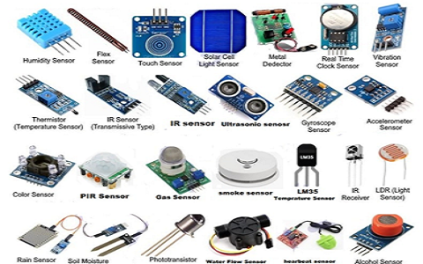
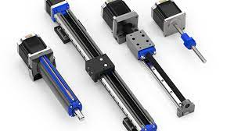

Slide 8
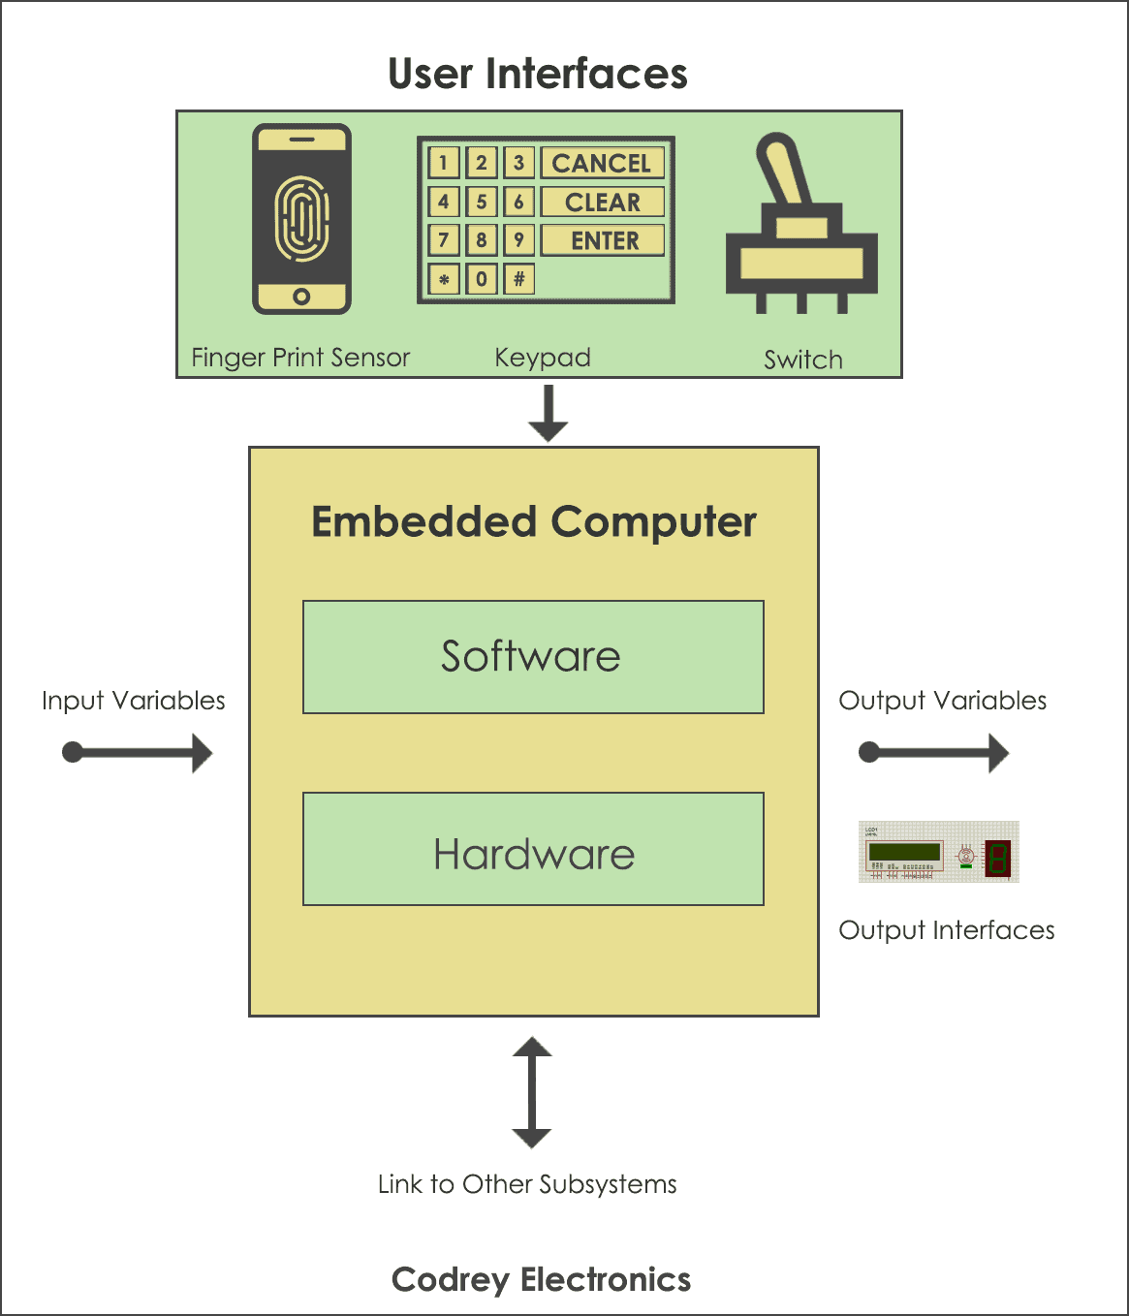
How embedded system works?
Embedded systems are managed by microcontrollers or digital signal processors (DSP), these processing systems are integrated with components dedicated to handling electric and/or mechanical interfacing.

Slide 9
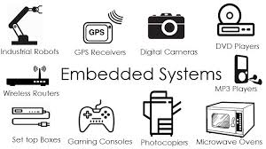
Significance?
Due to their compact size, low cost and simple design aspects made embedded systems very popular and encroached into human lives and have become indispensable. They are found everywhere from kitchen ware to space craft.

Slide 10
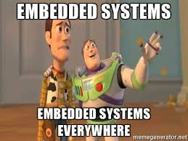
Embedded sytems everywhere?
Embedded systems span all aspects of modern life and there are many examples of their use:
Biomedical Instrumentation – ECG Recorder, Blood cell recorder, patient monitor system
Communication systems – pagers, cellular phones, cable TV terminals, fax and transreceivers, video games and so on

Slide 11
Application in Real Life
Remote control
Input: Buttons
Output: Modulated IR Signal
Brain: Microcontroller

Slide 12
Traffic Light Controller
Input: Presence sensor
Output: Traffic lights (red, yellow or green)
Brain: Microcontroller

Slide 13
Q&A session

Slide 14
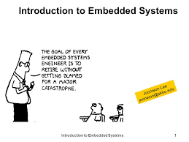
THE END

